Slide 1


Digital Signal Processing
(DSP)
Fundamentals

Slide 2
Overview
What is DSP?
Converting Analog into Digital
  Electronically
  Computationally
How Does It Work?
  Faithful Duplication
  Resolution Trade-offs

Slide 3
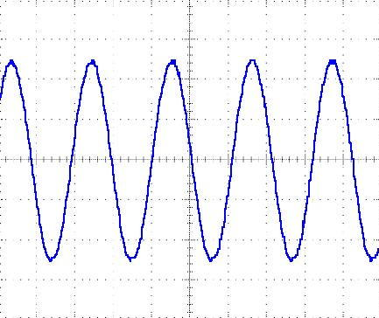
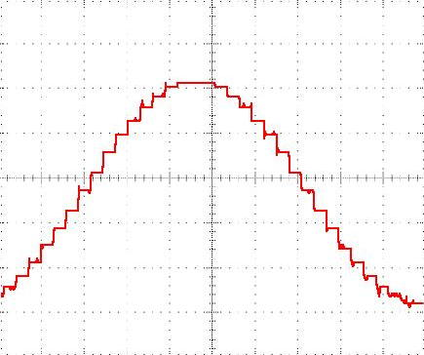
What is DSP?
Converting a continuously changing waveform (analog) into a series of discrete levels (digital)

Slide 4
What is DSP?
The analog waveform is sliced into equal segments and the waveform amplitude is measured in the middle of each segment
The collection of measurements make up the digital representation of the waveform

Slide 5
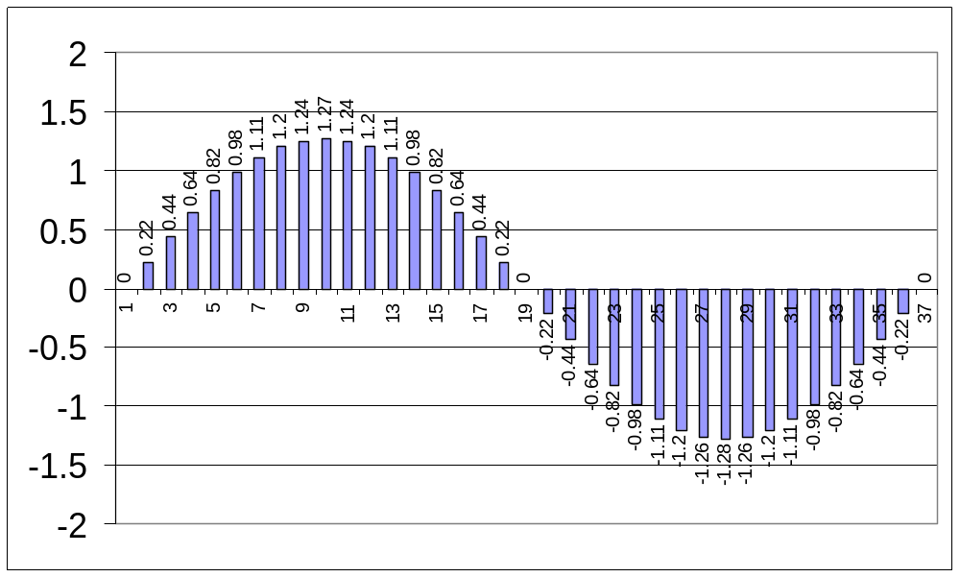
What is DSP?

Slide 6
Converting Analog into Digital
Electronically
The device that does the conversion is called an Analog to Digital Converter (ADC)
There is a device that converts digital to analog that is called a Digital to Analog Converter (DAC)

Slide 7
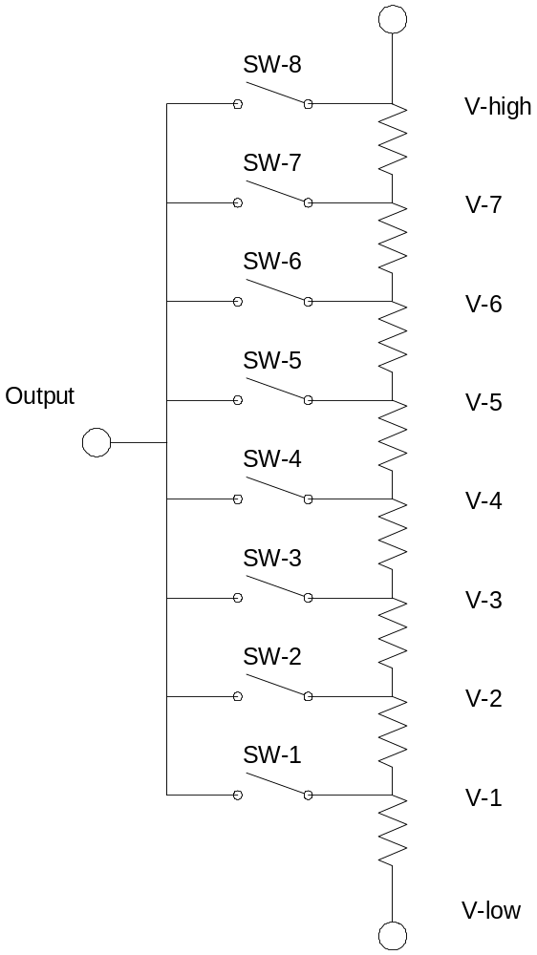
Converting Analog into Digital
Electronically
The simplest form of ADC uses a resistance ladder to switch in the appropriate number of resistors in series to create the desired voltage that is compared to the input (unknown) voltage

Slide 8
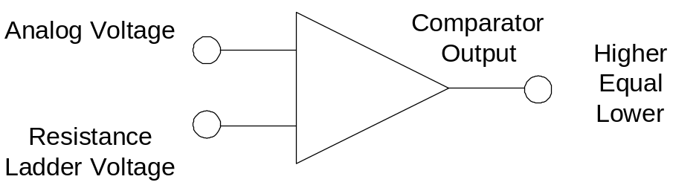
Converting Analog into Digital
Electronically
The output of the resistance ladder is compared to the analog voltage in a comparator
When there is a match, the digital equivalent (switch configuration) is captured

Slide 9
Converting Analog into Digital
Computationally
The analog voltage can now be compared with the digitally generated voltage in the comparator
Through a technique called binary search, the digitally generated voltage is adjusted in steps until it is equal (within tolerances) to the analog voltage
When the two are equal, the digital value of the voltage is the outcome

Slide 10
Converting Analog into Digital
Computationally
The binary search is a mathematical technique that uses an initial guess, the expected high, and the expected low in a simple computation to refine a new guess
The computation continues until the refined guess matches the actual value (or until the maximum number of calculations is reached)
The following sequence takes you through a binary search computation

Slide 11
Binary Search
Analog
Digital
Initial conditions
  Expected high 5-volts
  Expected low 0-volts
  5-volts 256-binary
  0-volts 0-binary
Voltage to be converted
  3.42-volts
  Equates to 175 binary
5-volts
256
3.42-volts
Unknown (175)
2.5-volts
128
0-volts
0

Slide 12
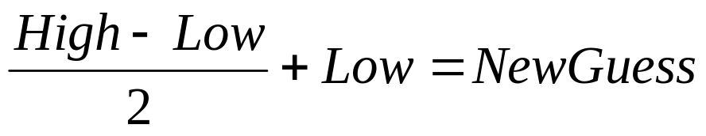
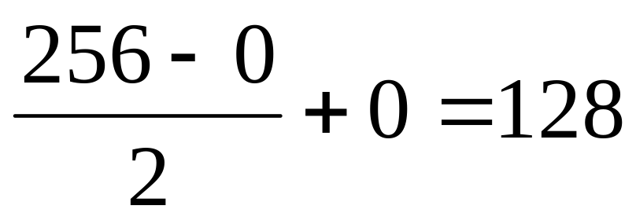
Binary Search
Binary search algorithm:
First Guess:
Analog
Digital
5-volts
256
3.42-volts
unknown
128
Guess is Low
0-volts
0

Slide 13
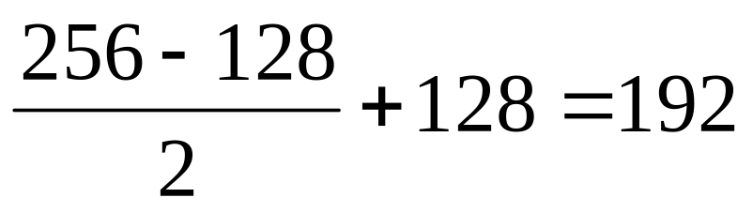
Binary Search
New Guess (2):
Analog
Digital
5-volts
256
192
3.42-volts
unknown
Guess is High
0-volts
0

Slide 14
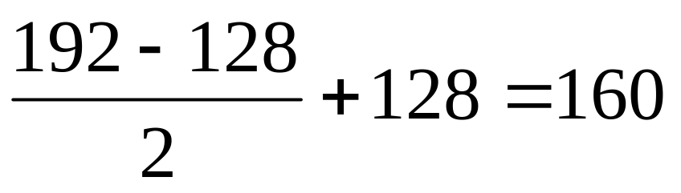
Binary Search
New Guess (3):
Analog
Digital
5-volts
256
3.42-volts
unknown
160
Guess is Low
0-volts
0

Slide 15
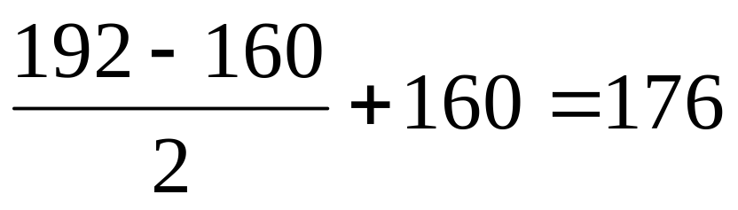
Binary Search
New Guess (4):
Analog
Digital
5-volts
256
176
3.42-volts
unknown
Guess is High
0-volts
0

Slide 16
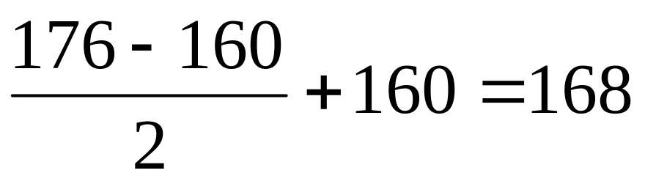
Binary Search
New Guess (5):
Analog
Digital
5-volts
256
3.42-volts
unknown
168
Guess is Low
0-volts
0

Slide 17
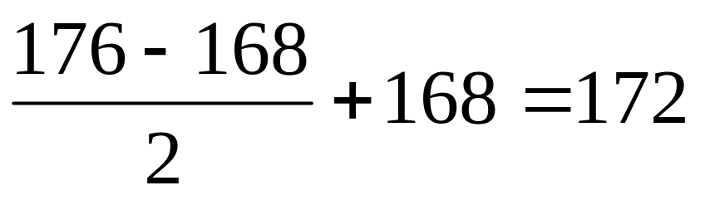
Binary Search
New Guess (6):
Analog
Digital
5-volts
256
3.42-volts
unknown
172
Guess is Low
(but getting close)
0-volts
0

Slide 18
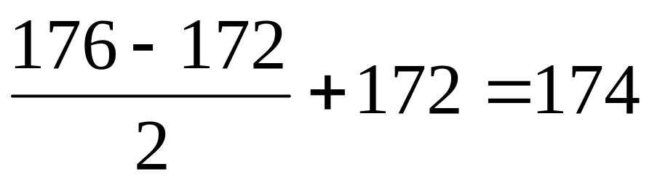
Binary Search
New Guess (7):
Analog
Digital
5-volts
256
3.42-volts
unknown
174
Guess is Low
(but getting really, really, close)
0-volts
0

Slide 19
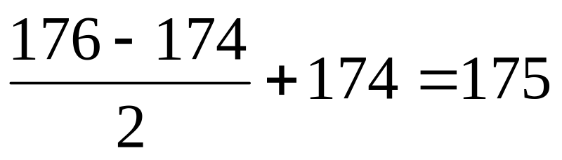
Binary Search
New Guess (8):
Analog
Digital
5-volts
256
3.42-volts
175!
Guess is Right On
0-volts
0

Slide 20
Binary Search
The speed the binary search is accomplished depends on:
  The clock speed of the ADC
  The number of bits resolution
  Can be shortened by a good guess (but usually is not worth the effort)

Slide 21
How Does It Work?
Faithful Duplication
Now that we can slice up a waveform and convert it into digital form, let’s take a look at how it is used in DSP
Draw a simple waveform on graph paper
  Scale appropriately
“Gather” digital data points to represent the waveform

Slide 22
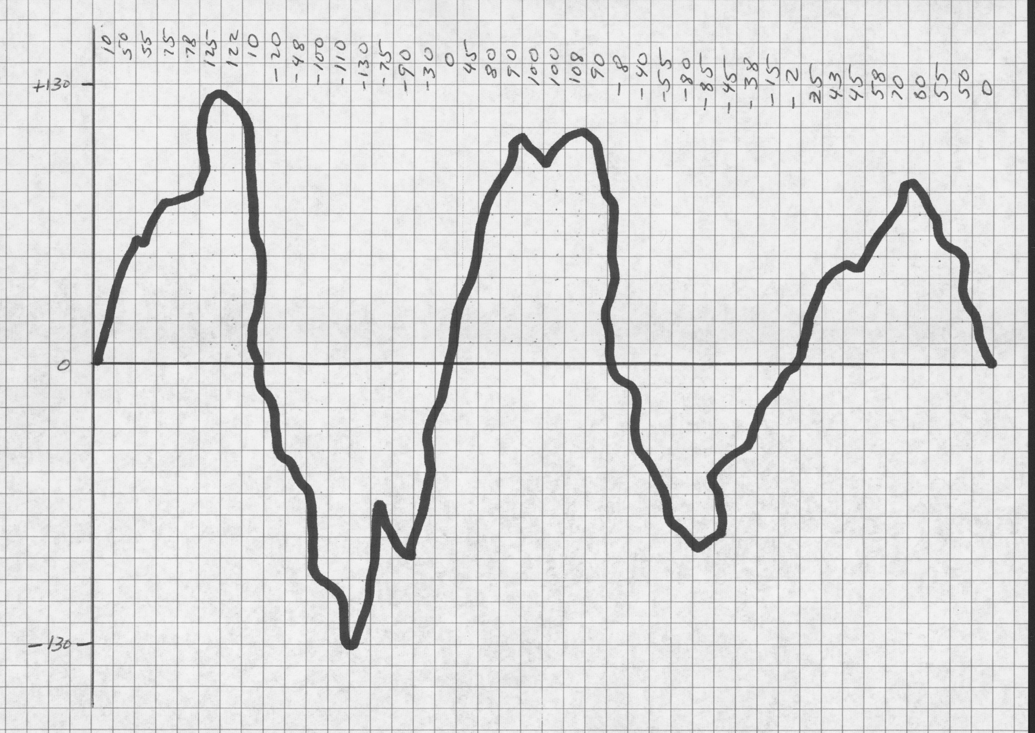
Starting Waveform Used to Create Digital Data

Slide 23
How Does It Work?
Faithful Duplication
Swap your waveform data with a partner
Using the data, recreate the waveform on a sheet of graph paper

Slide 24
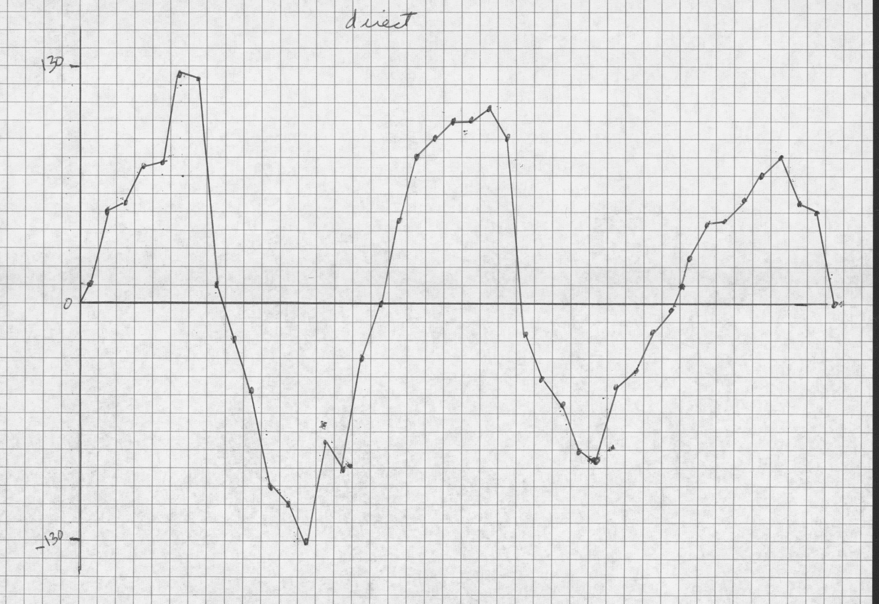
Waveform Created from Digital Data

Slide 25
How Does It Work?
Faithful Duplication
Compare the original with the recreating, note similarities and differences

Slide 26
How Does It Work?
Faithful Duplication
Once the waveform is in digital form, the real power of DSP can be realized by mathematical manipulation of the data
Using EXCEL spreadsheet software can assist in manipulating the data and making graphs quickly
Let’s first do a little filtering of noise

Slide 27
How Does It Work?
Faithful Duplication
Using your raw digital data, create a new table of data that averages three data points
  Average the point before and the point after with the point in the middle
  Enter all data in EXCEL to help with graphing

Slide 28
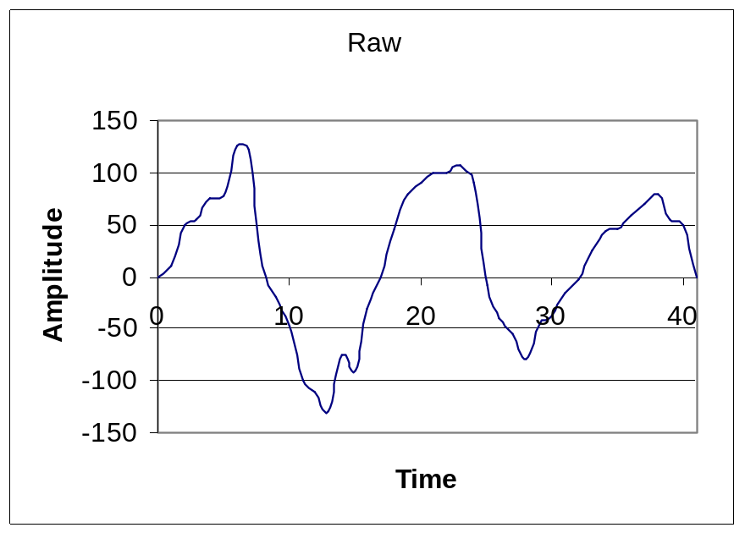
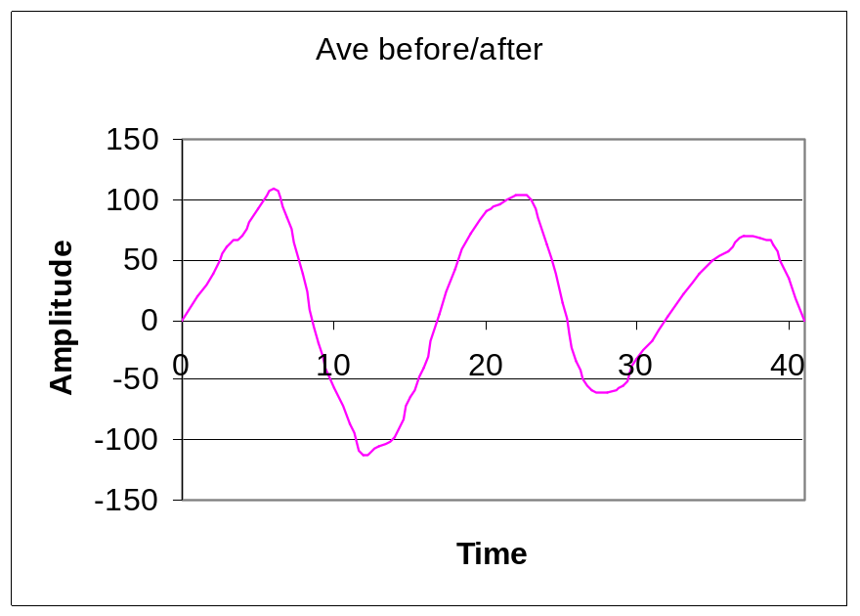
Noise Filtering Using Averaging

Slide 29
How Does It Work?
Faithful Duplication
Let’s take care of some static crashes that cause some interference
Using your raw digital data, create a new table of data that replaces extreme high and low values:
  Replace values greater than 100 with 100
  Replace values less than -100 with -100

Slide 30

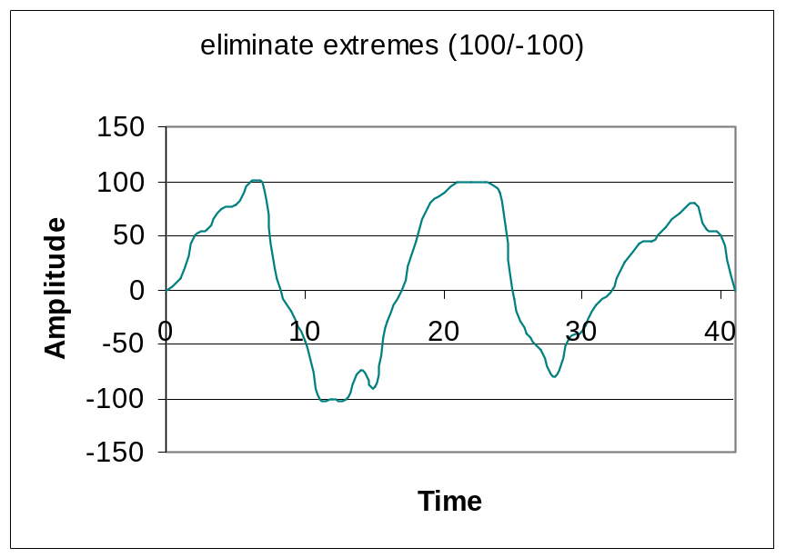
Clipping of Static Crashes

Slide 31
How Does It Work?
Resolution Trade-offs
Now let’s take a look at how sampling rates affect the faithful duplication of the waveform
Using your raw digital data, create a new table of data and delete every other data point
This is the same as sampling at half the rate

Slide 32

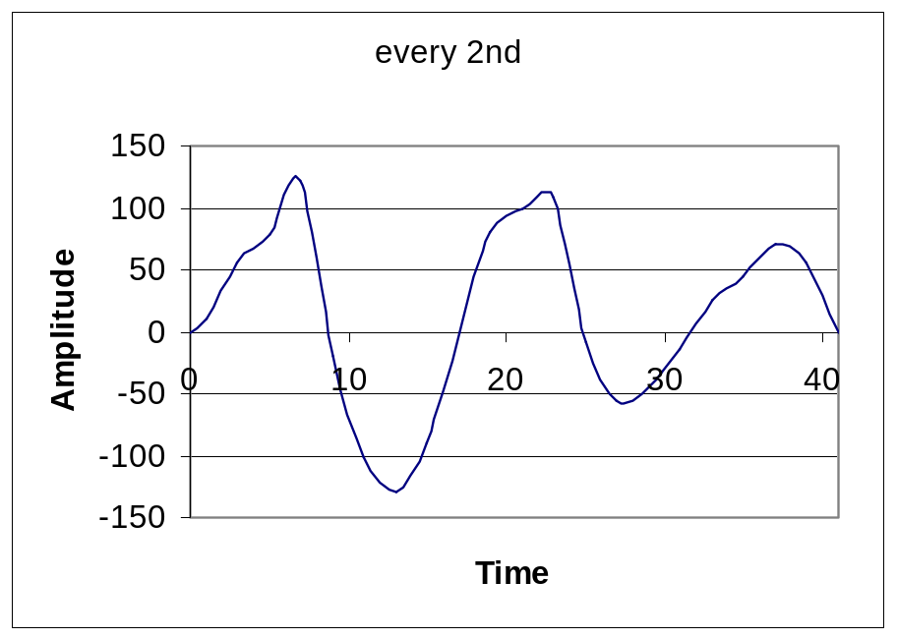
Half Sample Rate

Slide 33
How Does It Work?
Resolution Trade-offs
Using your raw digital data, create a new table of data and delete every second and third data point
This is the same as sampling at one-third the rate

Slide 34
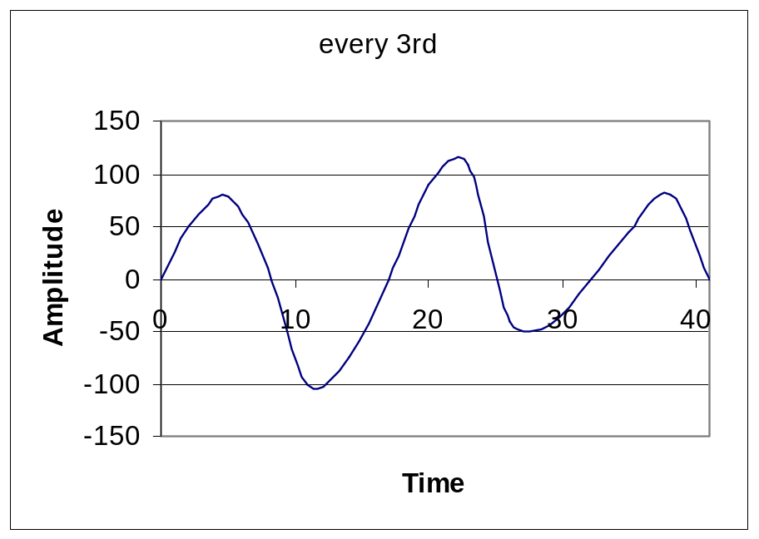
1/2 Sample Rate

Slide 35
How Does It Work?
Resolution Trade-offs
Using your raw digital data, create a new table of data and delete all but every sixth data point
This is the same as sampling at one-sixth the rate

Slide 36
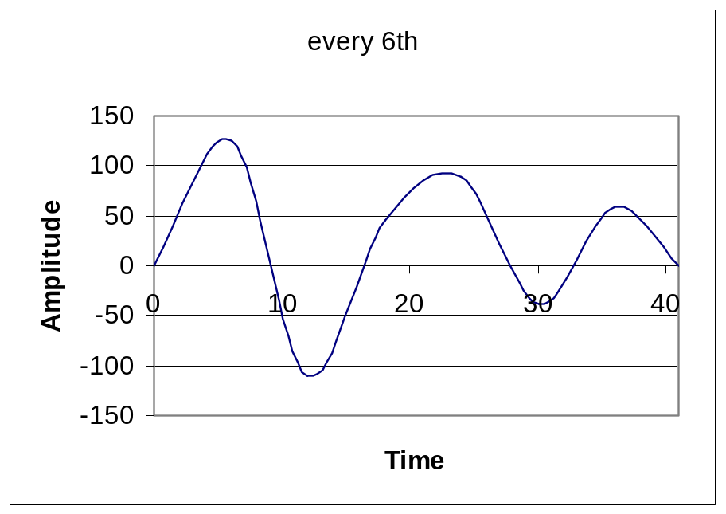
1/6 Sample Rate

Slide 37
How Does It Work?
Resolution Trade-offs
Using your raw digital data, create a new table of data and delete all but every twelfth data point
This is the same as sampling at one-twelfth the rate

Slide 38
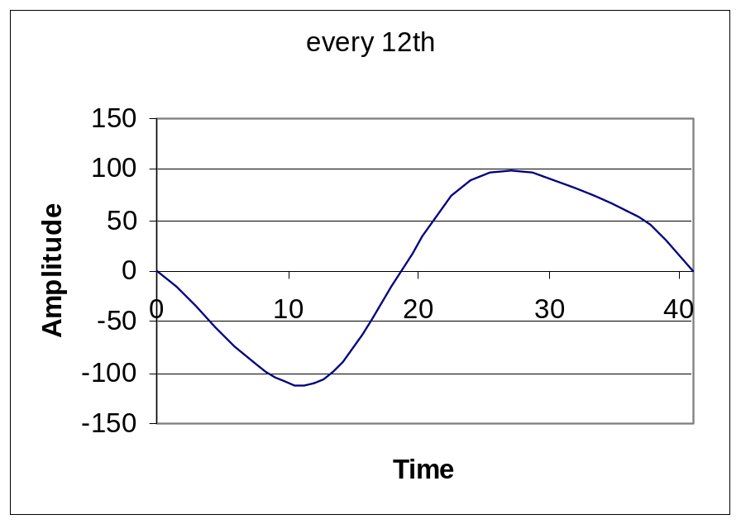
1/12 Sample Rate

Slide 39
How Does It Work?
Resolution Trade-offs
What conclusions can you draw from the changes in sampling rate?
At what point does the waveform get too corrupted by the reduced number of samples?
Is there a point where more samples does not appear to improve the quality of the duplication?

Slide 40
How Does It Work?
Resolution Trade-offs
Bit Resolution
High Bit Count
Good Duplication
Slow
Low Bit Count
Poor Duplication
Fast
Sample Rate
High Sample Rate
Good Duplication
Slow
Low Sample Rate
Poor Duplication
Fast

